Slide 1
Development Economics
Development Microeconomics
(by) Bardhan and Udry
Chapter 3

Slide 2
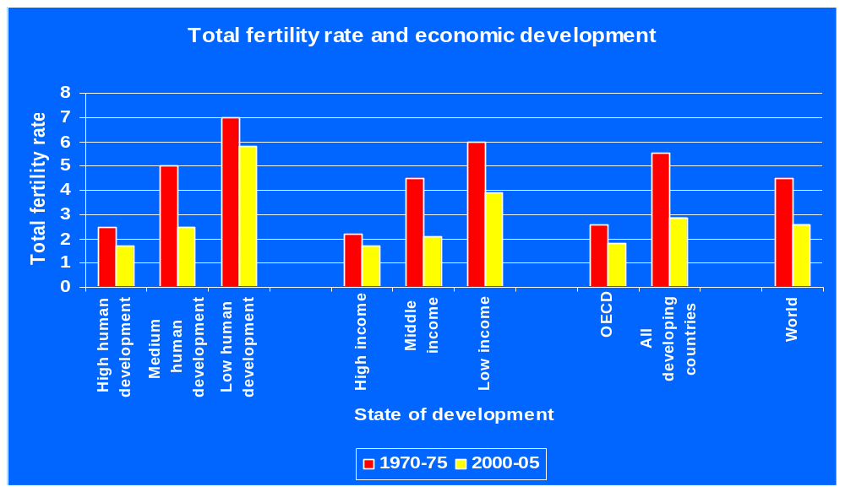
Development and fertility

Slide 3
Lessons
Malthusian trap has not been fulfilled as many countries have succeeded in sustaining increases in income per capita
Fertility is declining everywhere as development has been proceeding. It was not in countries of SSA where development has not been occurring
Across countries also fertility is higher in higher income countries and countries that invest more in education (human capital)
But population growth is also due to mortality decline

Slide 4
Population growth
Driven by a rapid decline in mortality rates in developing countries, accompanied by a more modest drop in the fertility rates
Has not resulted in a Malthusian crisis
  Per capita income in most developing countries continue to rise, and mortality rates in these countries continue to decline
Is population growth good or bad for income growth:
  Factors of production exhibit diminishing returns → bad
  Factors of production exhibit increasing returns → good
  Smithian Dynamics Technology change. Boserup: Population growth stimulates technological change

Slide 5
Solow growth model
Output of a country is determined by the amount of capital available to each worker, and on technology
  Production function: Y = A.f(K, L)
  Constant returns to scale ⇒ Y/K = A.f(K/L) ⇒ y = A.f(k)
Capital per labourer increases if there is an increase in the aggregate level of savings in the economy, and decreases with the depreciation rate and with addition to the labor force
  Δk = s.f(k) – (δ + n)k
Steady state
  Capital per worker (and hence output per worker) increases at a constant rate (assumed to be zero)
    Δk = 0 ⇒ s.f(k) = (δ + n)k

Slide 6
Impact of population growth in this model
Production function: f(k)
Accumulation of capital: s.f(k)
Use of capital: (n + δ)k
Steady state:
  s.f(k) = (n + δ)k
Population growth rate increases: n’ > n
Capital per worker and output per worker decline (k’* < k*; y’* < y*)
y
y*
y’*
f(k)
(n’ + δ)k
(n + δ)k
s.f(k)
k’* k* k

Slide 7
Unitary household model of fertility [1]
Parents’ utility
  U = U(x, n, z; α)
    x ≡ parents’ consumption of goods and services
    n ≡ number of children
    z ≡ average quality of children or human capital
    α ≡ exogenous factors
Human capital of children
  z = Z(c, t; β)/n
    c ≡ children’s consumption of goods and services
    t ≡ proportion of endowed time parents spend on children
    β ≡ exogenous factors

Slide 8
Unitary household model of fertility [2]
Assumption
  Total endowment of time per set of parents is 1 (What about grandparents, child care)
Optimisation problem of parents
  Max U(x, n, z; α) α include return to skills, HH structure
  Sub to
  z = Z(c, t; β) β include cost of education, parents’HC
  w(1 – t) = p_{x}x + p_{c}c
Trade off
  Between greater consumption of goods and services, the number of children they raise, and the human capital (or quality) of these children

Slide 9
Unitary household model of fertility [3]
Impact of economic growth
  Increase in wage rate (w)
  Increase in (relative) returns to skilled labor (α)
  Greater provision of public goods like education (β)
Implication for empirical research
  Household income is endogenous to the choice of number (and quality) of children since labor time and allocation of consumption goods are also involved
Shortcomings
  Does not take into consideration impact of inter-gender differences in fertility preferences
  Does not take into consideration impact of social norms

Slide 10
Women’s fertility preference
Women bear the entire physical risk of bearing children
  In Africa, 1 in 100 births result in the death of the mother
  They also are usually involved in most of the child care
Women have different preferences with respect to number of children, and on portion of household resources spent on children
  Additional income in the hands of mothers result in larger increases in child health and education than similar increase in the incomes of the fathers (Thomas)
  Women may depend more heavily on their children
Women’s fertility rates decline with their level of educational attainment, and the quality of children rises
  Higher opportunity cost of time
  Greater preference for education, and greater efficiency in passing on education to children
  Greater bargaining power vis-à-vis others in the household

Slide 11
Impact of social norms [1]
Social norms
  Household i’s utility from children would depend on the number of children of other households in the peer group, or the society in which they live (preferences of other relatives like grandparents) (Dasgupta 1993, Cooper and John 1988) e.g. Because of competition for power or prestige within the village
    Externalities associated with having children (wage effects)
    Fertility decisions of household involve “strategic complementarities”
Children should take care of parents in their old age but this affected by influences like % time of children in home vs time in school, urban vs rural location
Characterization of strategic complementarity
  Number of households = M
  Vector of children of households ≡ X = (X₁, X₂, …., X_{M})
  Household utility function = U_{i}(X)
  Externality ⇒ ∂²U(.)/∂X_{i}∂X_{j} > 0, for i ≠ j

Slide 12
Impact of social norms [2]
Optimisation problem for household i
  Max U_{i}(X)
  Utility of a household is subject to diminishing marginal utility with respect to the number of its own children.
Definition
  X_{-i} ≡ (X₁, …., X_{i-1}, X_{i+1}, …., X_{M})
Implication
  For each X_{-i}, the household i will have an unique value for the optimal number of children
    X*(X_{-i}) is household i’s reaction function
    ∂X*(.)/∂X_{j} > 0

Slide 13
Influence of strategic interaction
While each HH may optimize on n for given number by other hhs.
But when the observe increased n of other hhs , they may update their optimization and affect n

Slide 14
Impact of social norms [3]
Assumption
  All households have identical preferences
Symmetric Nash equilibrium
  Each household will have the same number of children
  X_{i}* = X_{j}* = Z, i.e. intersections with 45º line
X*(Z) is reaction function
Multiple equilibria
  The actual outcome will depend on expectations which, in turn, are driven by cultural norms
X*
45⁰ line
C
X*(Z)
B
A
No,children of other HH Z

Slide 15
Other impact of social environment [1]
Economy
  Small families
  Labor is relatively scarce
  Adult wages are high
    Adults can afford to keep children outside the labor force
    Adults have a preference for small families
    Large families may have opposite incentives, low adult wages, parents have little education so child learning less efficient
Assumptions
  Adults will send children to work only if adult income is very low; i.e., child leisure is a luxury good
  Adult and child labor are substitutes for each other
  Working children are net contributors to the economic benefit of the families

Slide 16
Other impact of social environment [2]
Model characterisation (Basu and Van)
  N families
  Each family has 1 adult and m children
  Adult consumes c, each child consumes βc, β < 1
  Adult labor supply is inelastic; household chooses child labour e ∈ {0, 1}
Household preferences
  (c + δ, e) > (c, e)
    Higher consumption is preferred to lower consumption
  (c + δ, 1) > (c, 0) if c < s
  (c + δ, 1) < (c, 0) if c > s
    Child labor is preferred only if the consumption of the household falls below some low threshold

Slide 17
Other impact of social environment [3]
Household budget constraint
  c + m.β.c = m.e.w_{c} + w_{a}
Children work only if adult consumption falls below a threshold s
  If w_{a} > (1 + mβ)s
    c = w_{a}/(1 + mβ)
    e = 0 ⇒ Adult labor supply = N; Child labor supply = 0
  If w_{a} < (1 + mβ)s
    c = (w_{a} + mw_{c})/(1 + mβ)
    e = 1 ⇒ Adult labor supply = N; Child labor supply = mN

Slide 18
Other impact of social environment [4]
Production in Firm i
  f(A_{i} + γC_{i}), γ < 1
    A_{i} ≡ adult labor; C_{i} ≡ child labor
    1/ γ children can do the same amount of work as an adult
Firms are price taking
  γw_{a} < w_{c} ⇒ adult labour is cheaper ⇒ there is no demand for child labor
  γw_{a} > w_{c} ⇒ child labour is cheaper ⇒ there is no demand for adult labor
  γw_{a} = w_{c} ⇒ the firm is indifferent between adult labour and child labor
Market clearing condition
  Demand for adult labour equals supply of adult labor
  Demand for child labour equals supply of child labor

Slide 19
Other impact of social environment [5]
D Curve is the Aggregate Demand for Labor
Assumption
  γw_{a} = w_{c}
Assume Fertility level = m^{l}
Labor supply
  If w_{a} > (1 + m^{l}β)s, only adult labor
    Equilibrium at E⁰
  If w_{a} < (1 + m^{l}β)s, both adult and child labor
    Equilibrium at E¹
If Fertility level increases to m^{h}
  equilibrium at E²
w_{a}
w⁰
(1+m^{h}β)s
(1+m^{l} β)s
w¹
w²
S^{l}. S^{h}
E⁰
E¹
E²
S^{l}
S^{h}
D
N (1+γm^{l})N (1+γm^{h})N D

Slide 20
Will fertility behavior respond to these conditions?
Equilibrium E⁰
  Wage = w⁰
  c(m^{l}) = w⁰/(1 + m^{l}β) > w⁰/(1 + m^{h}β) = c(m^{h})
  Only low fertility equilibrium is possible and only adults work
Equilibrium E¹
  Adult wage = w¹; Child’s wage = γw¹
  c(m^{l}) = w¹(1 + m^{l} γ)/(1 + m^{l}β) < w¹(m^{h}γ)/(1 + m^{h}β) = c(m^{h})
    A child is a net contributor to the family’s welfare: γ > β
  Thus Low fertility equilibrium is not possible and so E¹ is not an equilibrium
Equilibrium E²
  Adult wage = w²; Child’s wage = γw²
  c(ml) = w¹(1 + m^{l} γ)/(1 + m^{l}β) < w²(m^{h}γ)/(1 + m^{h}β) = c(m^{h})
  Only high fertility equilibrium is possible

Slide 21
E⁰ > E² for each HH
But, since other households choose high fertility, this pushes wage rates down so that each HH chooses high fertility
To deal with this coordination failure, strong policy interventions can be justified.
Child labor ban may help or hurt

